Slide 1
UI VS UX

Slide 2
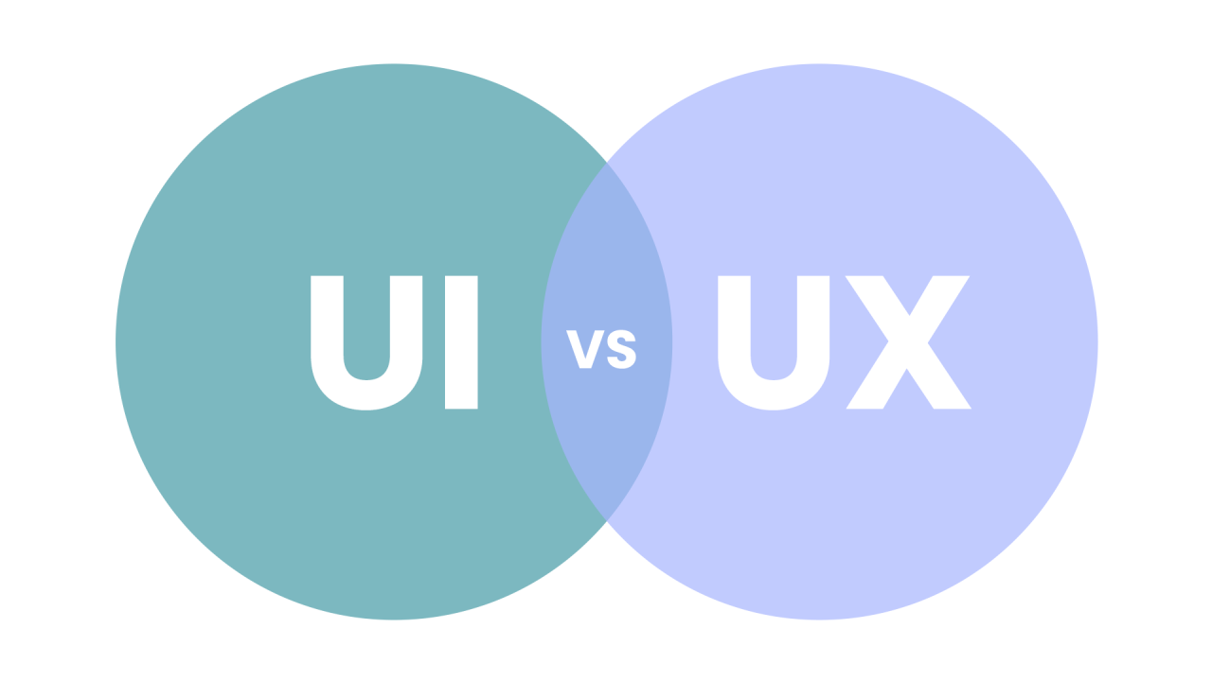
WHAT DO UI AND UX MEAN?
🎀UI STANDS FOR USER INTERFACE
🎀UX STANDS FOR USER EXPERIENCE

Slide 3
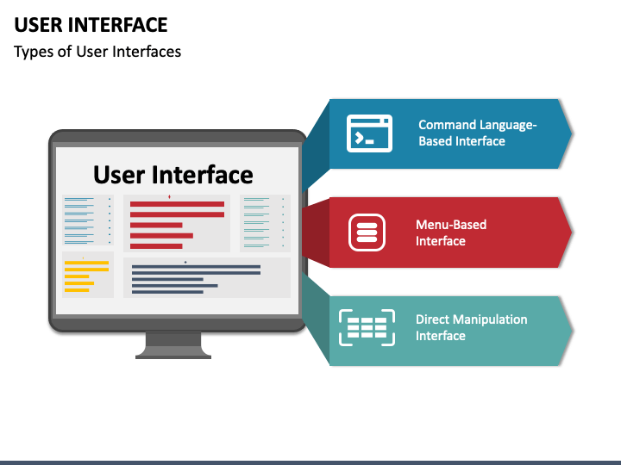
What is UI (User Interface)?
UI Stands for User Interface. It is the look, feel, and design of a device or app everything a person touches, sees, or clicks to use a computer, phone, or website.
Key parts of UI:
Buttons and icons: pictures and words you press to make things happen.
Colors and fonts: the style, shades, and text types that make an app look nice

Slide 4
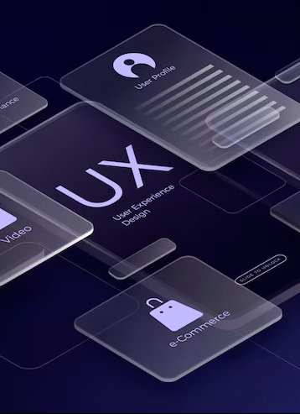
UX Stands for User Experience. It means how a person feels and reacts when they use a product, system, or service. It covers ease of use, speed, and overall satisfaction.
Key parts of UX:
1. Ease of use: How simple it is to do a task without confusion.
2. Usefulness: Whether the product solves a real problem for the user.
What is UX (User Experience) ?

Slide 5
DIFFERENCE BETWEEN UI & UX
LOOK AND FEEL
BRAND COLORS
TYPOGRAPHY
PLEASING IMAGES
EASY TO USE
SATISFYING
EASY NAVIGATION
ACCESSIBILITY
UI
UX

Slide 6
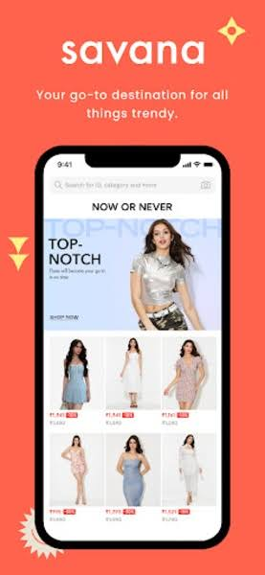
SAVANA – UI VS UX
Key UI elements:
Product Catalog & Cards - Clean grid layout with fashion images,price, and category filters like Dresses, Tops, Bottoms.
Cart, Wishlist, Search Bar- Add to cart, save favorites, live search.
Key UX features:
Smooth Shopping Flow - Add to cart with size/color, quantity controls, automatic total calculation.
Smart AI Recommendations- Suggests complementary accessories, full outfits, and shows “match score%”
How UI and UX work together in Savana?
Ui attracts: beautiful product photo, clean layout,and animation make the app look premium
Ux keep you: ai try-on + smart recommendations solve the biggest online shopping problem: “Will this fit me?”
Result: Users can browse easily.

Slide 7
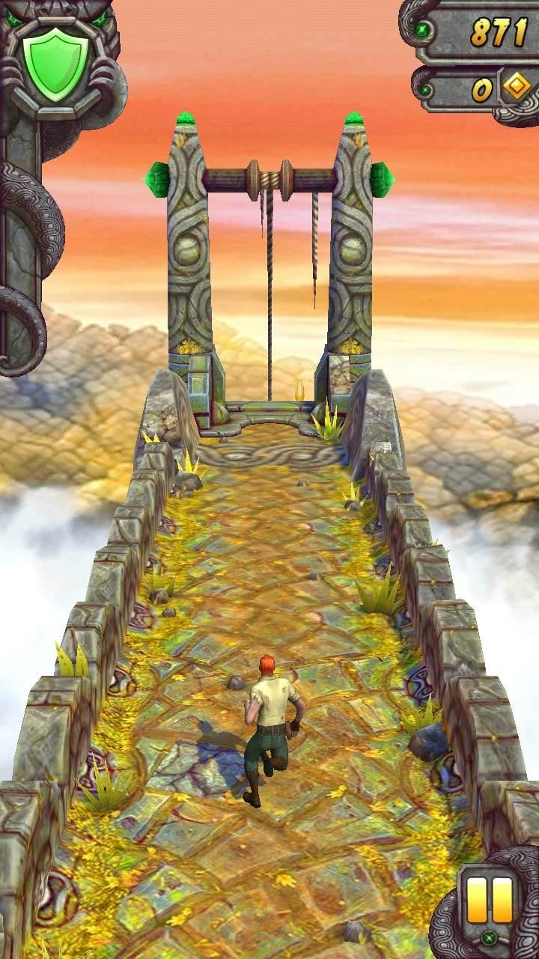
TEMPLE RUN – UI VS UX
Key UI elements:
Gameplay Sunscreen - 3D view of character running forward. Left/Right/Swipe arrows are not shown. You just swipe.
Controls UI - No buttons on screen during run. Swipe up=Jump, Swipe down=Slide, Tilt=Turn. Keeps screen clean
Key UX features :
One-hand gameplay - Only 4 swipes needed. Super easy to learn, hard to master. Perfect for mobile
Feedback – Screen shake, sound effects, coin “ching” sound. Makes every action feel satisfying
How UI and UX work together in Temple Run?
UI helps UX: Clean screen with no buttons means you can focus 100% on running and obstacles
UX needs UI: Bright coins and big obstacles are easy to see, so you can react fast with swipes.
Result: The simple UI removes confusion. That’s why kids to adults play it for hours.

Slide 8

RED BUS – UI VS UX
Key UI elements:
Home Screen Search Bar- Big “From”, “To”, “Date” boxes at the top. CTA button: “Search Buses” in red.
Brand Colors- Red + White them. Builds trust and brand recall.
Key UX features :
Fast Search + Filters- Find buses in 3 clicks. Filters for AC, Sleeper, Ratings, Boarding points save time.
Live Bus Tracking- See real-time bus location after booking. Reduces anxiety.
How UI and UX work together in Red Bus?
UI helps UX: The seat map UI makes it easy to choose “window seat” without confusion. Red color for selected seat = instant feedback.
UX needs UI: Clean bus cards with rating + price upfront help users decide in 10 seconds instead of calling agents.
Result: Because UI is simple and UX builds trust, people prefer booking on Red Bus instead of at the bus stand.

Slide 9
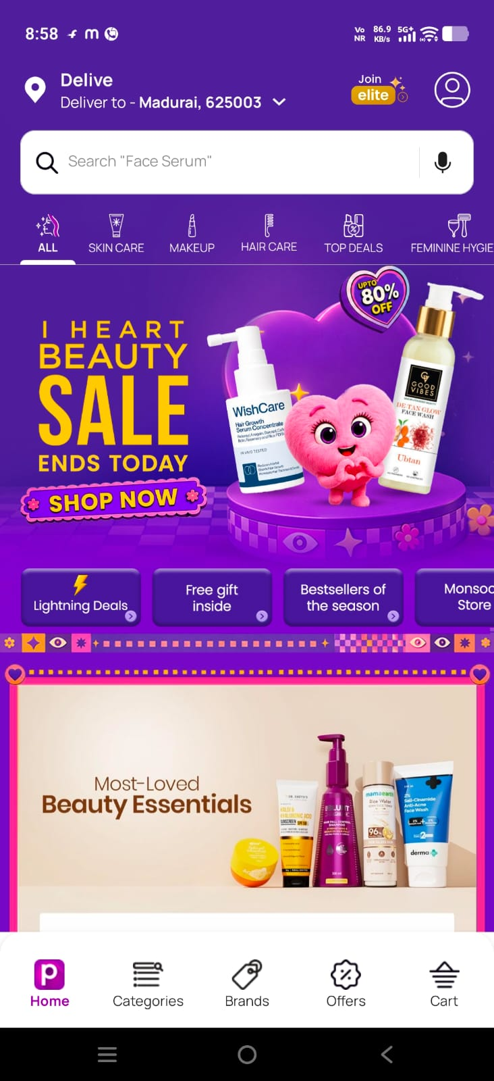
PURPLE – UI VS UX
Key UI elements:
Brand color System- Purple + White + Soft gradients. Gives a premium, calm, modern feel.
Clean Typography- Rounded, friendly fonts. Lots of white space to avoid white
Key UX features:
Low Friction Actions- 1-tap like, 1-tap add to cart, Guest checkout. Reduces drop-offs.
Accessibility- High contrast purple om white, large tap targets, works on low network.
How UI and UX work together in Purple?
UI attracts: The calming purple color makes users feel relaxed and premium, not pushy.
UX retains: Personalized recommendations + easy checkout/trail makes people actually buy or match.
Result: UI creates the “Purple brand vibe” and UX delivers the promise of “comfort + simplicity”

Slide 10
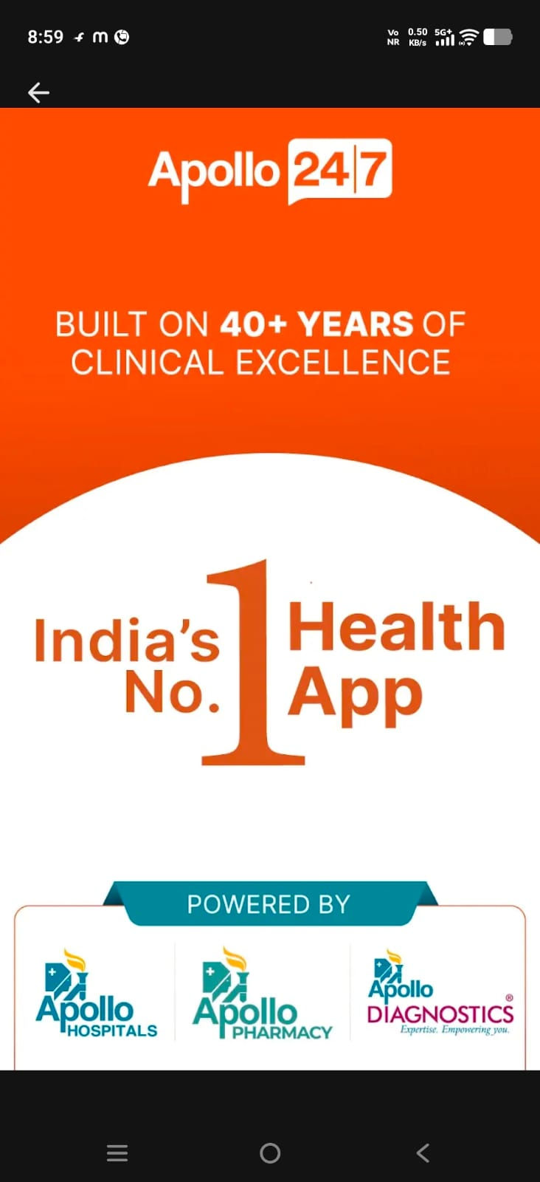
APOLLO 24/7 – UI VS UX
Key UI elements:
Home Dashboard- 4 big cards: Consult Doctors, Order Medicines, Book Lab Tests, Health Records. Green + White theme for trust
Doctor Cards- Photo, Name, Specialization, Experience, Fees, Rating, “Next Available” slot. Easy to scan.
Key UX features:
3-Step Booking- Select doctor>Choose slot> Pay. Can be done in<60 seconds
Consult Options- Video, Chat, and In-person. Instant15min doctor chat for emergencies.
How UI and UX work together in Apollo 24/7?
UI helps UX: Big “Consult Now” button + doctor ratings UI helps users decide fast during emergencies.
UX needs UI: Clean medicine page with “Add to Cart” + prescription upload reduces errors.
Result: Because UI looks professional and UX removes hospital queues, people use it
for quick queues, people use it for quick consults + lab tests at home.

